Slide 1

Process Mining Virtual InternShip
by
D. Charan Kumar
214G1A3212
Department of Computer Science and Engineering (Data Science)
Srinivasa Ramanujan Institute of Technology
(Affiliated to JNTUA & Approved by AICTE) (Accredited by NAAC with ‘A’ Grade & Accredited by NBA (EEE, ECE & CSE)
Rotarypuram Village, B K Samudram Mandal, Ananthapuramu – 515701.
2023 - 2024

Slide 2

Contents
Course Objective
Introduction
Technology
Applications
Modules
Real Time applications
Learning outcomes
GitHub Link
Queries

Slide 3
Course Objective
Process mining applies data science to discover and improve workflows by combining data analytics and data mining.
Process mining validates how a system works on certain plan.
Process mining explains plan of action and how decisions are taking in a system.
Process mining real-life data sets, and practical skills to directly apply the theory

Slide 4
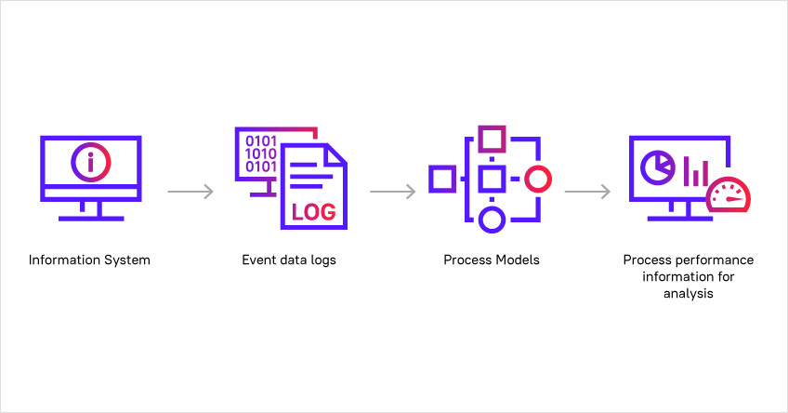
Introduction

Slide 5
Introduction
Process mining applies data science to discover, validate and improve workflow.
A process is a series of actions or steps repeated in a progression from a defined or recognized start to a defined or recognized finish.
Process mining is specifically focused on analyzing and optimizing business processes within an organization.

Slide 6
Technology
Process mining focuses on different perspectives, such as control-flow, organizational , case, and time.
Process mining is a widely used technology to model, analyze, and optimize business processes
Process mining focuses on different perspectives, such as control-flow, organizational, case, and time.
It can be integrated with other technologies like business intelligence, machine learning, robotic process automation

Slide 7
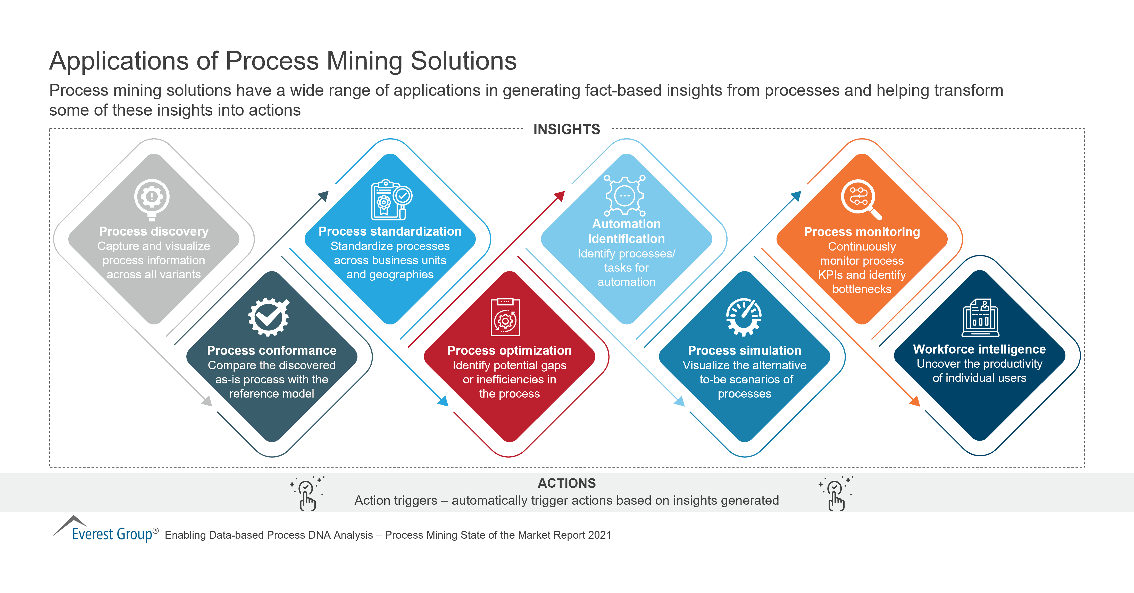
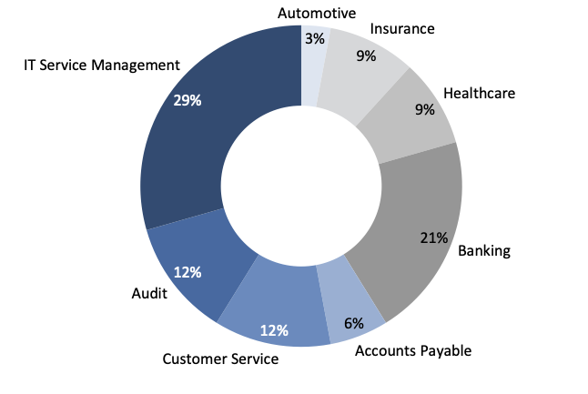
Applications

Slide 8
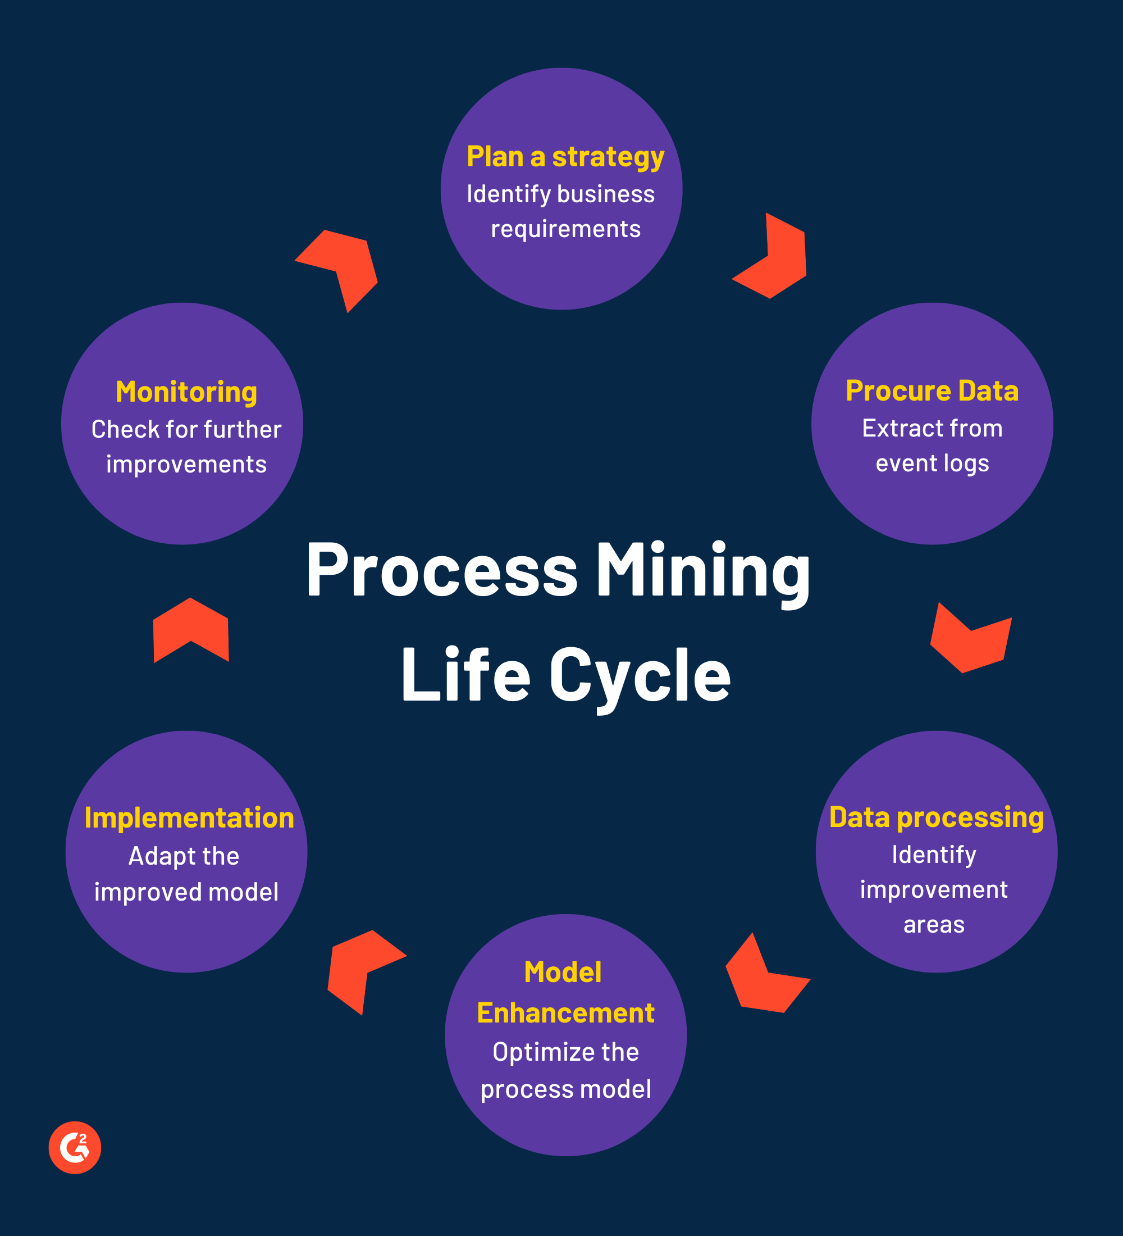
Modules
Modules involved in process mining are
1.Plan a strategy
2.Procure Data
3.Data Processing
4.Model Enhancement
5.Implementation
6.Monitoring

Slide 9

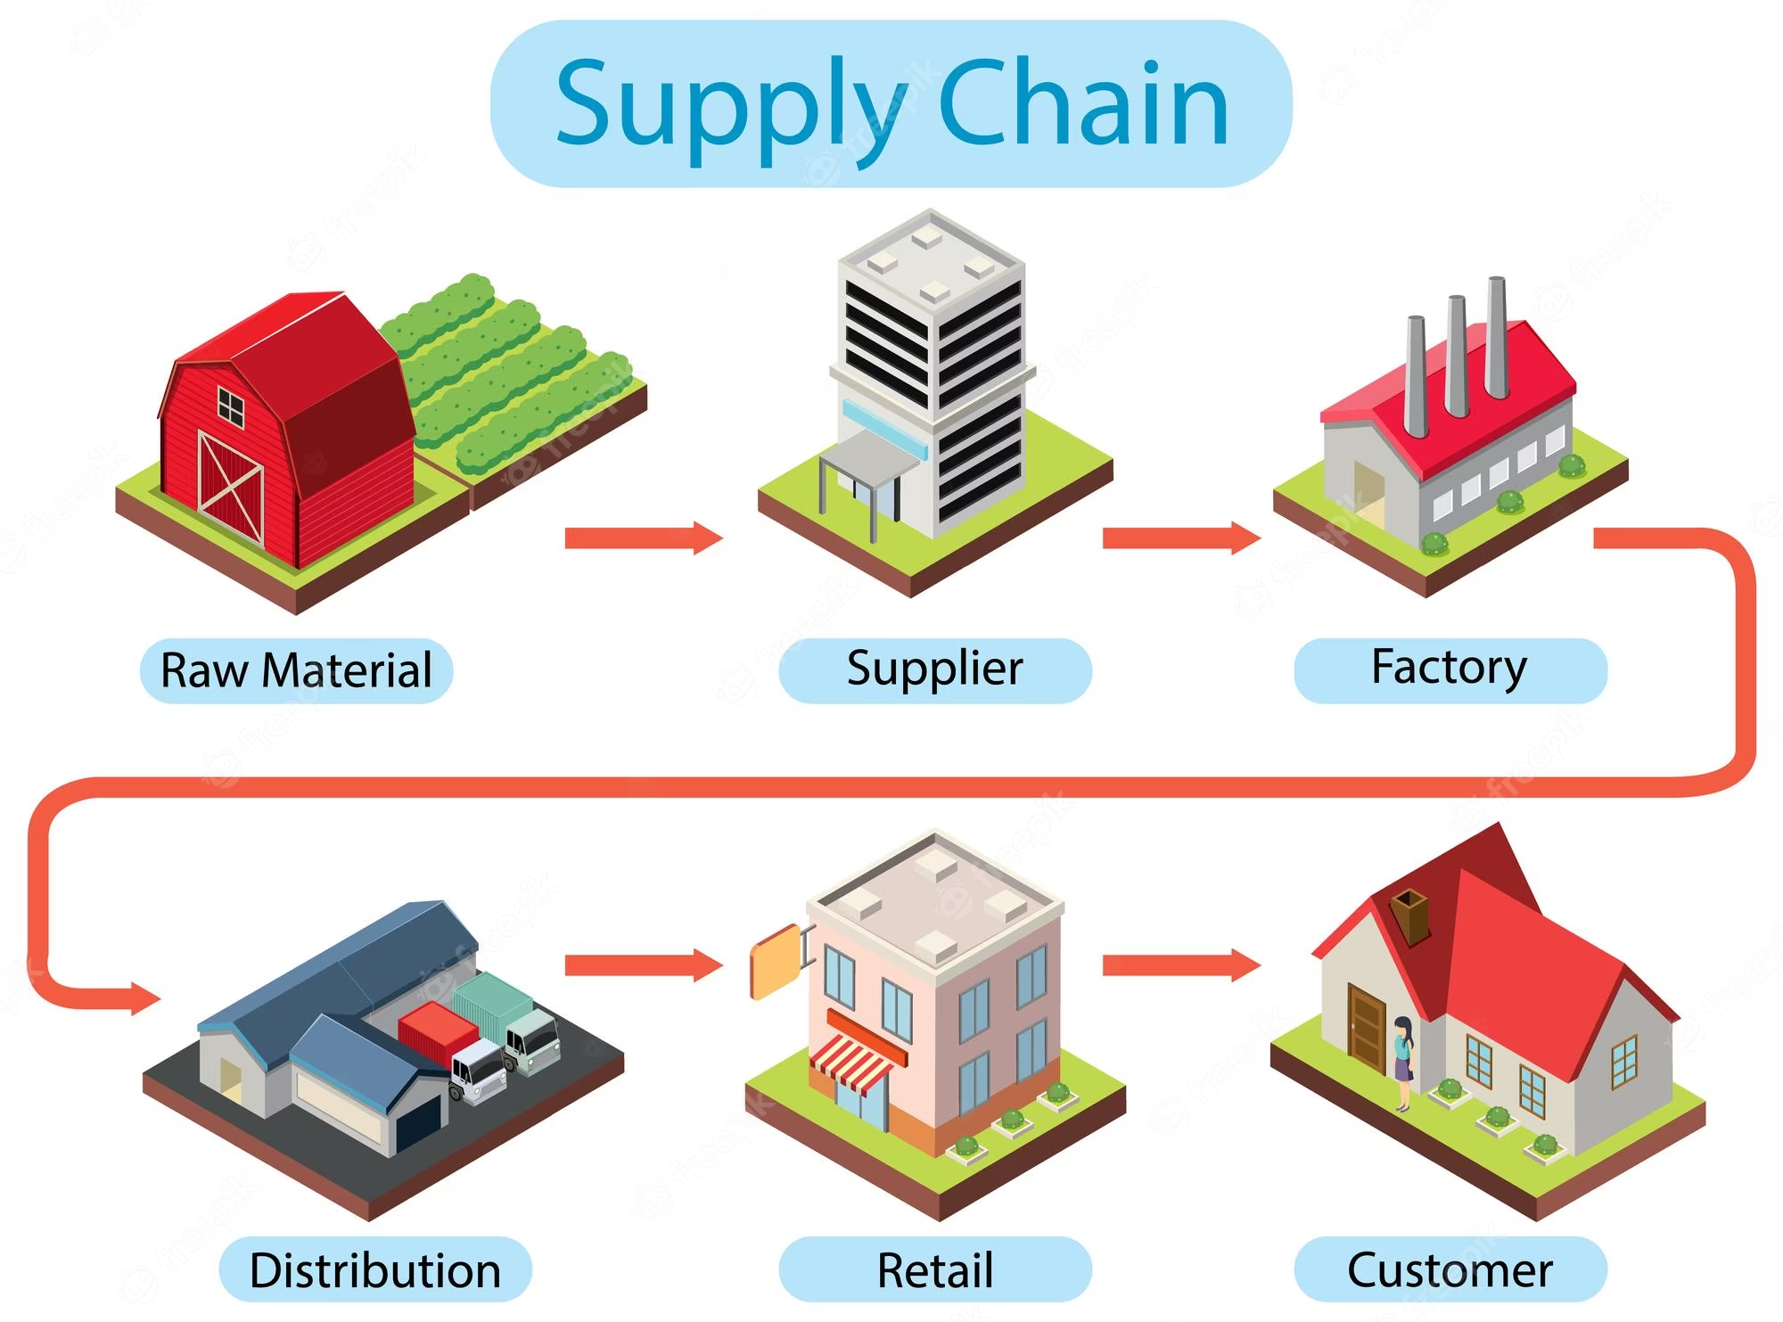
Real Time Applications

Slide 10

Real Time Applications
Process mining in logistics aims to optimize logistics operational efficiency and improve customer experience.
It identify problems like late deliveries and their root causes to prevent possible supply chain distribution.

Slide 11
Learning Outcomes
We’ll learn how various business processes works within an organisation like process flow, decision points.
We’ll learn how to clean, preprocess and analyze the data to extract meaningful insights and identify patterns.
We’ll learn how to work with process mining tools and softwares.
We’ll address the issues whether they are related to work flow design or resource allocation in process mining.

Slide 12
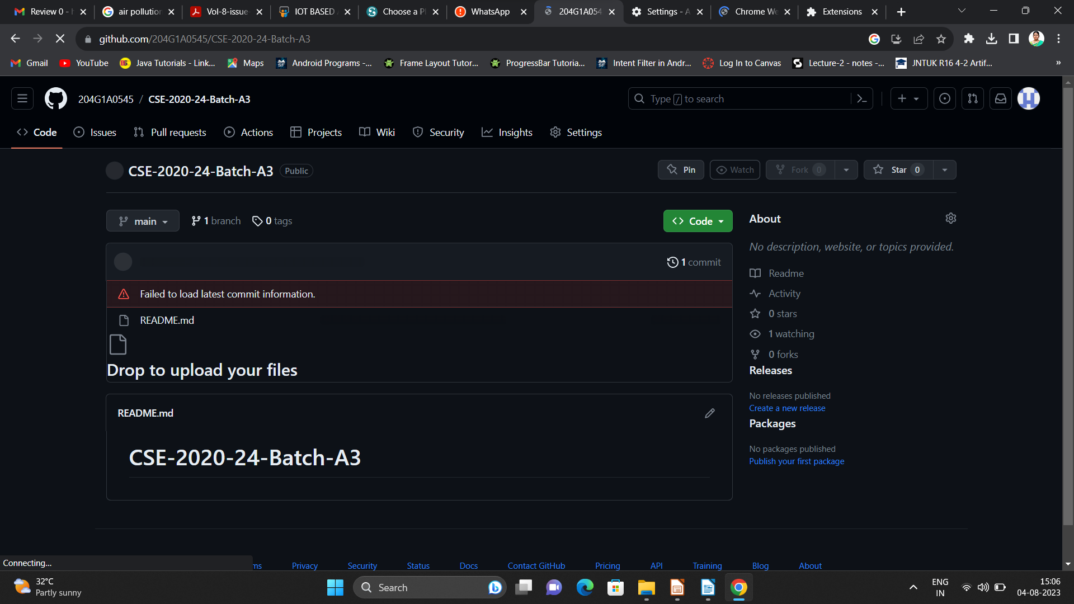

Git Hub Dashboard
Repository Name Like: Summer Internship - I
Under that include document, presentation and Certificate(Pdf).

Slide 13
Any Queries?

Slide 14
Thank You!!!

